Slide 1
Color Crafting Data Analysis
INFO 5871 INTRO TO DATA SCIENCE
Keke Wu
Notes:
Hi there, so for this final presentation, I used the data we collected on Amazon Mechanical Turk as part of the research effort in our lab for the Color Crafting project I’ve been working on, and did an analysis of it. To collect the data, we designed a web-based experiment and recruited 35 professional designers across the world to finish a set of tasks about visualization, we recorded their responses and demographics onto our lab server.

Slide 2
Color in Visualization
Notes:
Some background for you to understand the context of the data:

Slide 3
Color in Visualization
Encode Numerical Values
Distinguish Categories
Notes:
In visualization, color ramps are a set of colors that are often used to either encode numerical values or to distinguish different categories.

Slide 4
Color in Visualization
Encode Numerical Values
Notes:
Like in the GitHub contribution heatmap, different shades of green have different weights, the darker the green, the more contributions you’ve made, and vice versa.

Slide 5
Color in Visualization
Distinguish Categories
Notes:
Or like in this map, 5 different colors are used to represent different regions across the US.

Slide 6
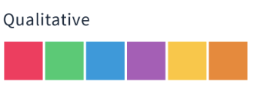
Color in Visualization
Notes:
Based on the relationships of each color in a given palette, color ramps can be furthered categorized into sequential color ramps, like on the left side, the colors in a palette kind of go from left to right, light to dark,
Or like in the middle, the diverging color ramps, where the colors go from light to dark from the midpoint,
Or like on the right, the qualitative color ramps, where there doesn’t seem to be any apparent relationship between these colors and they are used pretty much to just encode different categories.

Slide 7
Color Crafting
Automate the Construction of Designer Quality Color Ramps
Kmeans Model
Bayesian Model
Designer Crafted Ramps
Linear Approach Generated Ramps
Notes:
Our research focused pretty much on the numerical encoding side, we built 2 models, namely the k means model and the Bayesian model, we used machine learning to automate the generation of high quality color sequential and diverging color ramps for visualization design. We compared the color ramps generated by our models with those hand-crafted by designers and those made by traditional linear approach.

Slide 8


High Quality Color Ramp
Distinguishable
Pleasant Looking
Notes:
By high quality ramps, I mean in a given color ramp, the colors should be distinguishable enough from each other to encode distinct values, while also yield a pleasant look when combined and applied onto a visualization.

Slide 9
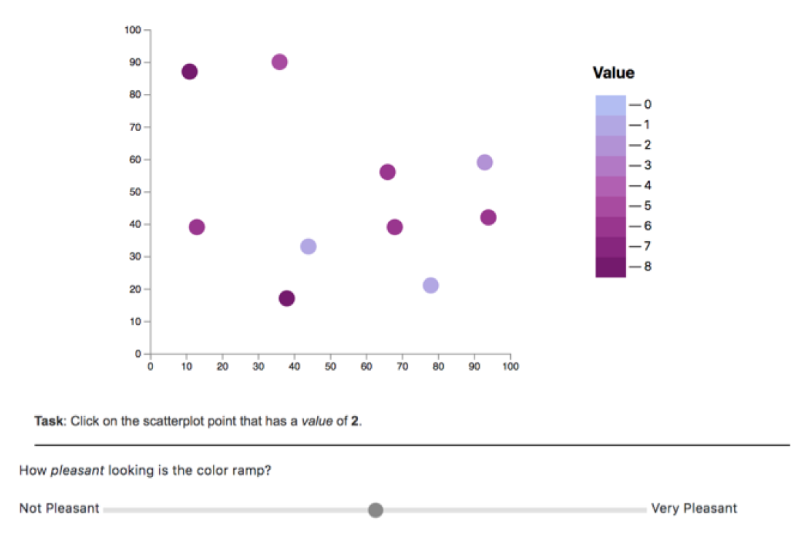
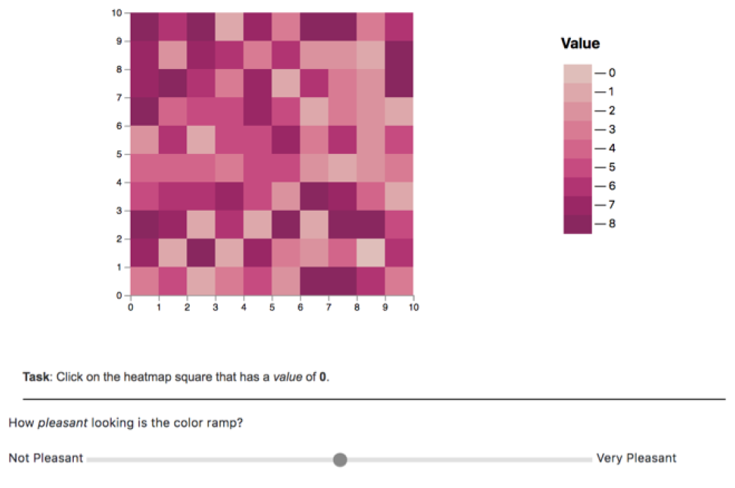
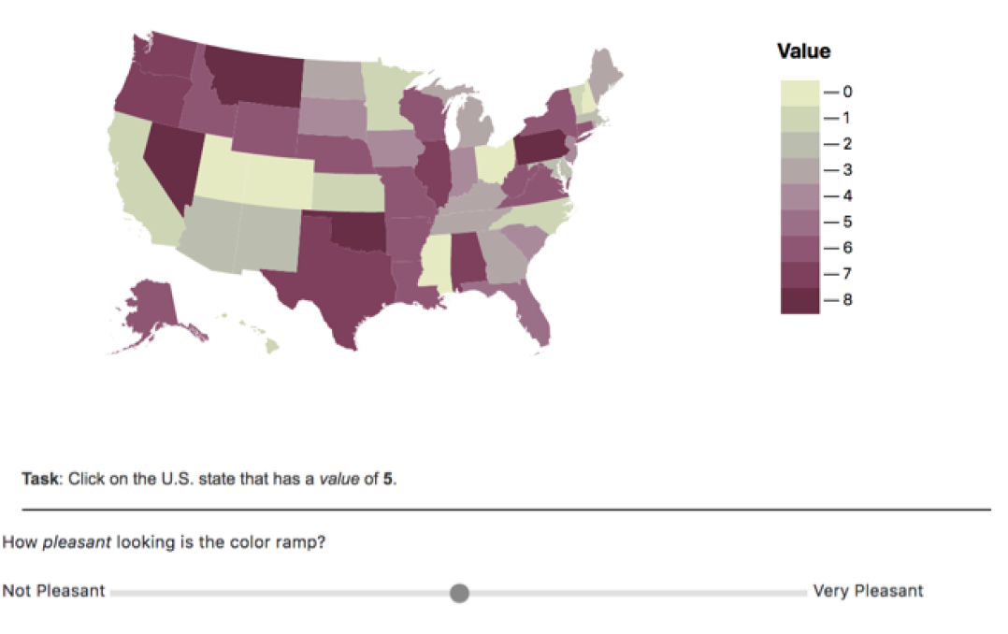
Color Crafting
Automate the Construction of Designer Quality Color Ramps
Notes:
In our experiment to collect data, we applied these ramps generated by our models onto visualization types like scatter plot, heatmap, and choropleth map, and we asked professional designers to select a colored point (as in the scatter plot) or square or state (as in the choropleth map) that encode a specific value, we also asked them how pleasant looking a ramp is, such that we can measure both the distinguishability and aesthetics of our ramps.

Slide 10
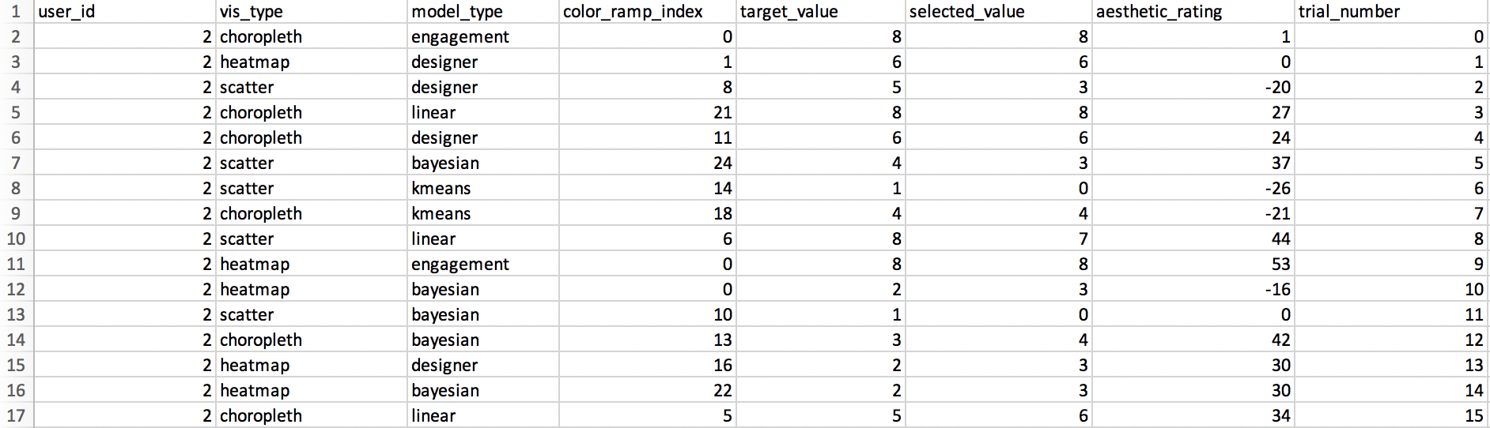
DATA DESCRIPTION
Response Data
Notes:
So we collected both the response data and demographics data.
In the response data spreadsheet, we have 8 columns, and about 1700 rows, with each one representing a single trial.
Among these columns, user_id is an identifier for different users, vis_type represents the three visualization types we used to generate the stimuli, namely the chorepleth map, heatmap, and scatter plot;
Model_type has the information about the color model used to render the visualization, including our kmeans and Bayesian model, the designer and linear model,
One thing to note is, there is also an engagement check, which is just an overly easy task to make sure the subject is paying close attention while doing the study, if they by any chance fail any of these checks, their results will be removed from our database.
And the color_ramp_index also has no special meaning here except for serving as an id for our ramps, and the target_value and selected_value columns are the selected answer and the correct answer given each trial,
the aesthetic rating ranged from -100 to 100, with 0 representing a netural score. And lastly, the trial_number, where each participant was given 39 trials, to make sure they went through the whole study and each of our stimuli.

Slide 11
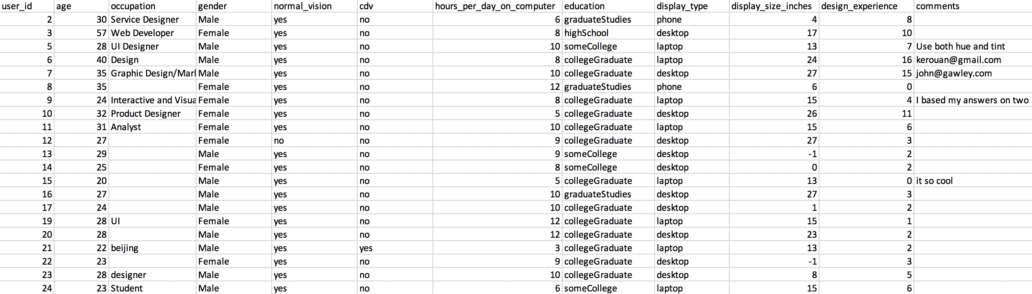
DATA DESCRIPTION
Demographics Data
Notes:
For the demographics data, we have 12 columns and 45 rows.
Similarly, user_id is to identify a specific user and to help us connect data across different tables, basic demographics including age, occupation, gender, a binary variable whether they have normal_vision, binary variable whether they have cdv (corrected vision), their education levels, their display type, and numerical variables of the display size, the years of their design experience, and open-ended free-text comments.

Slide 12
QUESTIONS
What is the numerical mapping accuracy for each model?
What is the average aesthetic rating for each model?
What are the important factors that may influence designers’ aesthetic rating?
Notes:
Given the goal of this project is to use color to support accurate numerical judgement as well as keeping a great level of aesthetics, my initial questions after looking at the data were:

Slide 13
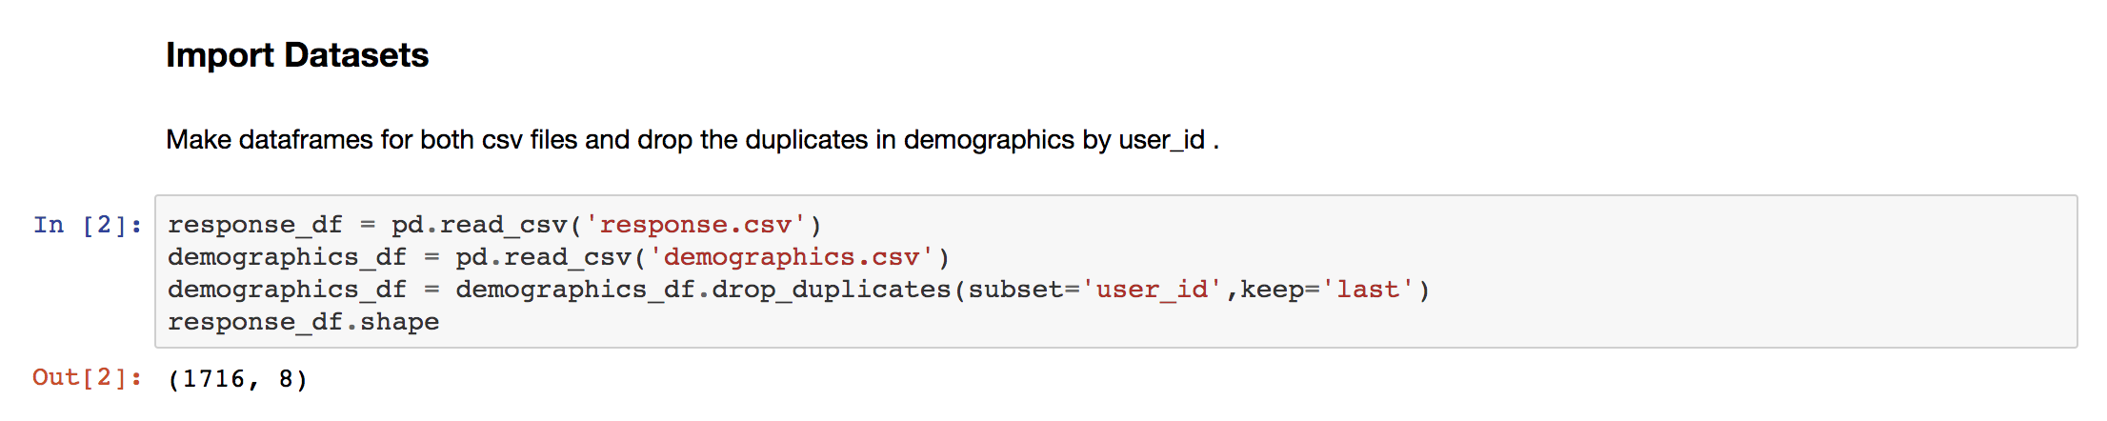
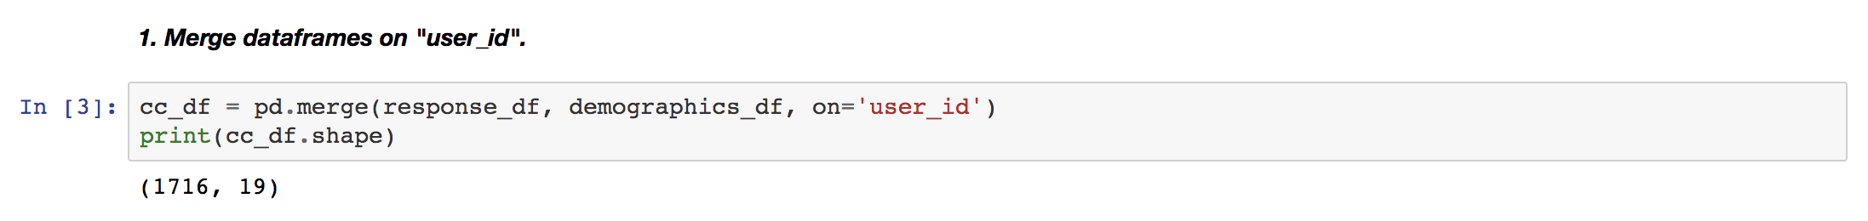
DATA CLEANING
Notes:
First, I cleaned the data by removing some extraneous information and data which was collected either of bad quality or didn’t meet our requirement.
In JupyterLab, i imported both csv files and checked on the user_id to see if there was any duplicates,

Slide 14
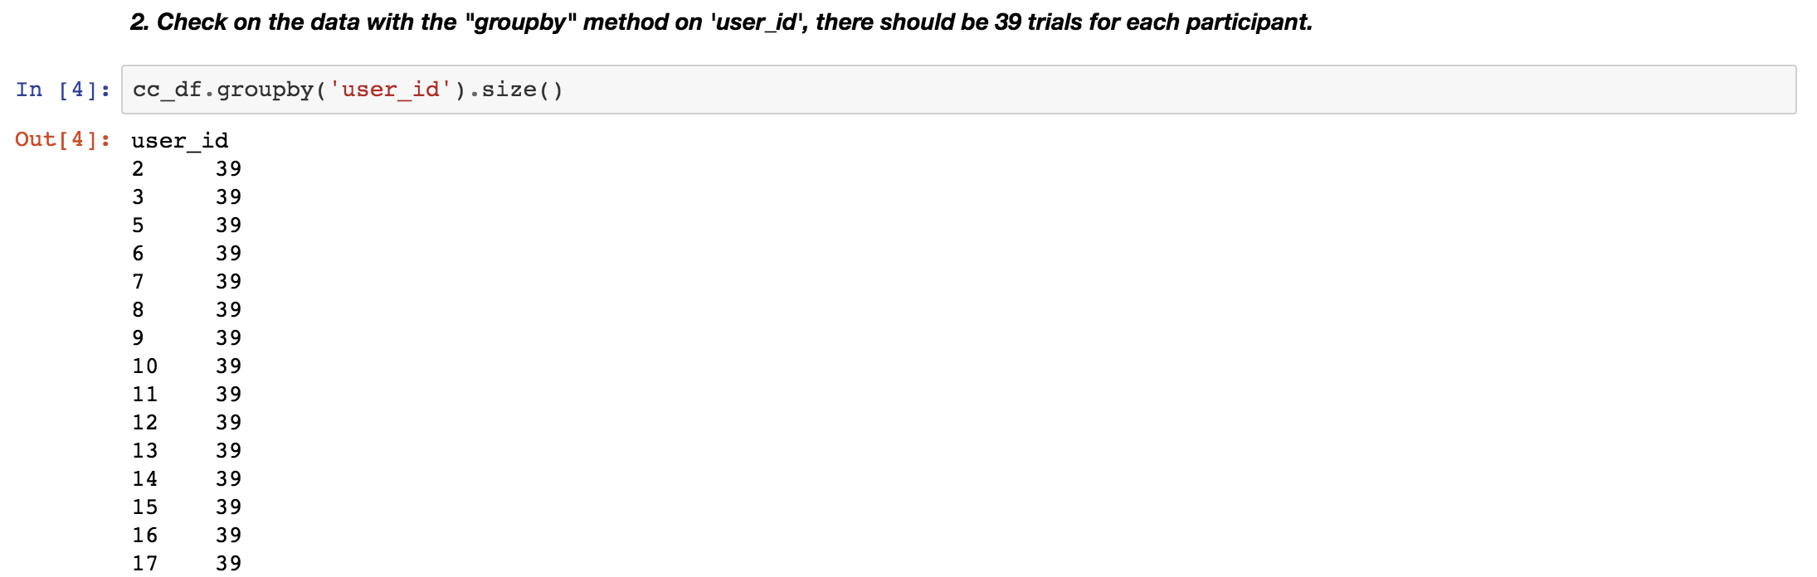
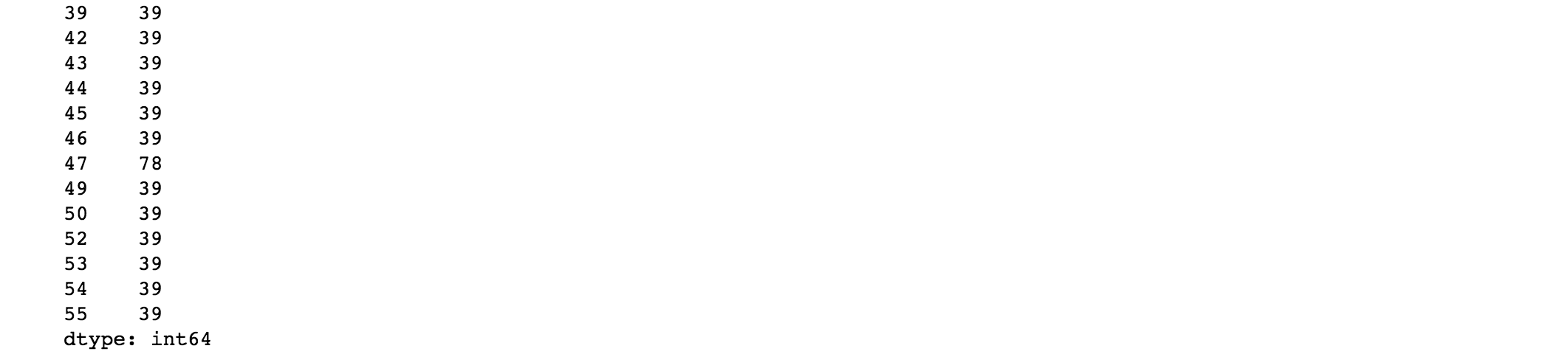
DATA CLEANING
Notes:
For example, after I grouped the dataframe by user_id, I found the 47th participant seemed to have finished this study twice,

Slide 15
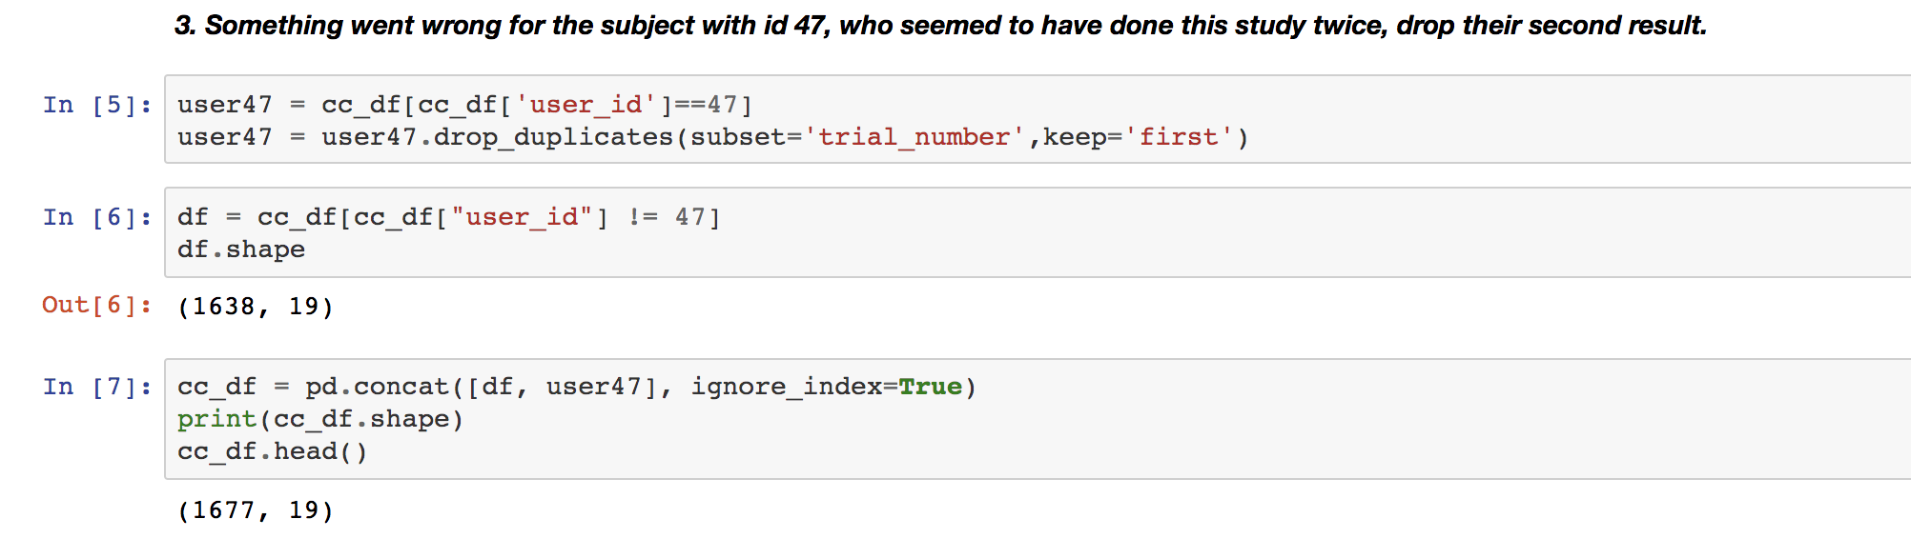
DATA CLEANING
Notes:
I dropped one of their results and updated the data frame.

Slide 16
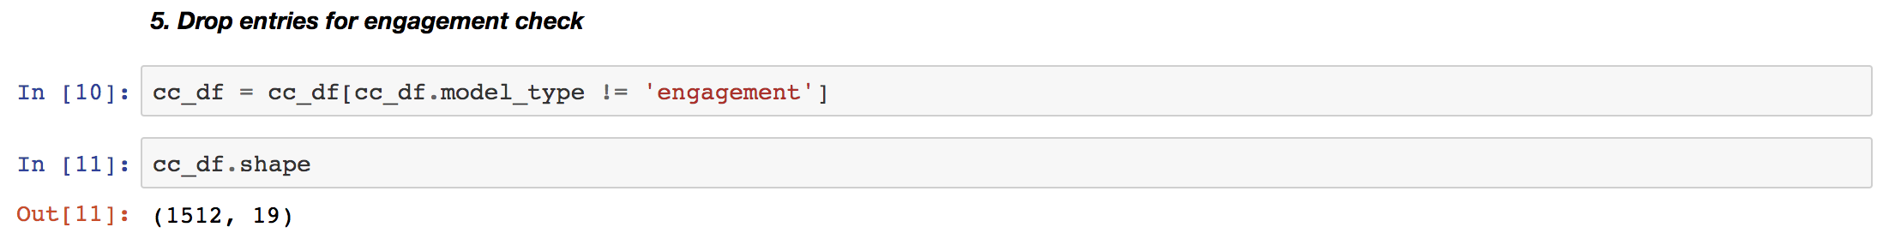
DATA CLEANING
Notes:
I also checked on the normal_vision column and filtered the data with our engagement check, after I did this, the new data frame had 1512 rows and 19 columns in total.
And I exported this data frame as a new csv file.

Slide 17
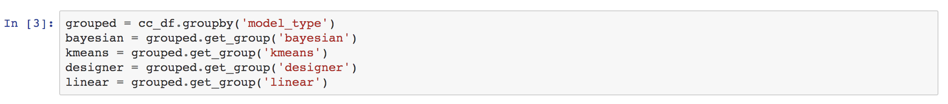
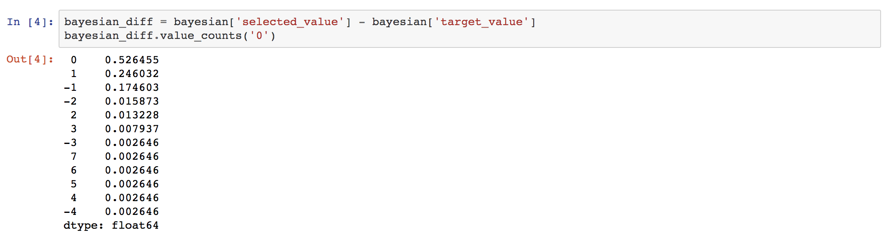
DATA ANALYSIS & VISUALIZATION
1. Accuracy & Aesthetics by Model Type
Notes:
Moving on to the data analysis, I wanted to know both the accuracy and aesthetic performance for each model, so I grouped the data frame by model_type, and calculated the accuracy by dividing the difference between selected value and target value by the total number of data within that model_type.

Slide 18
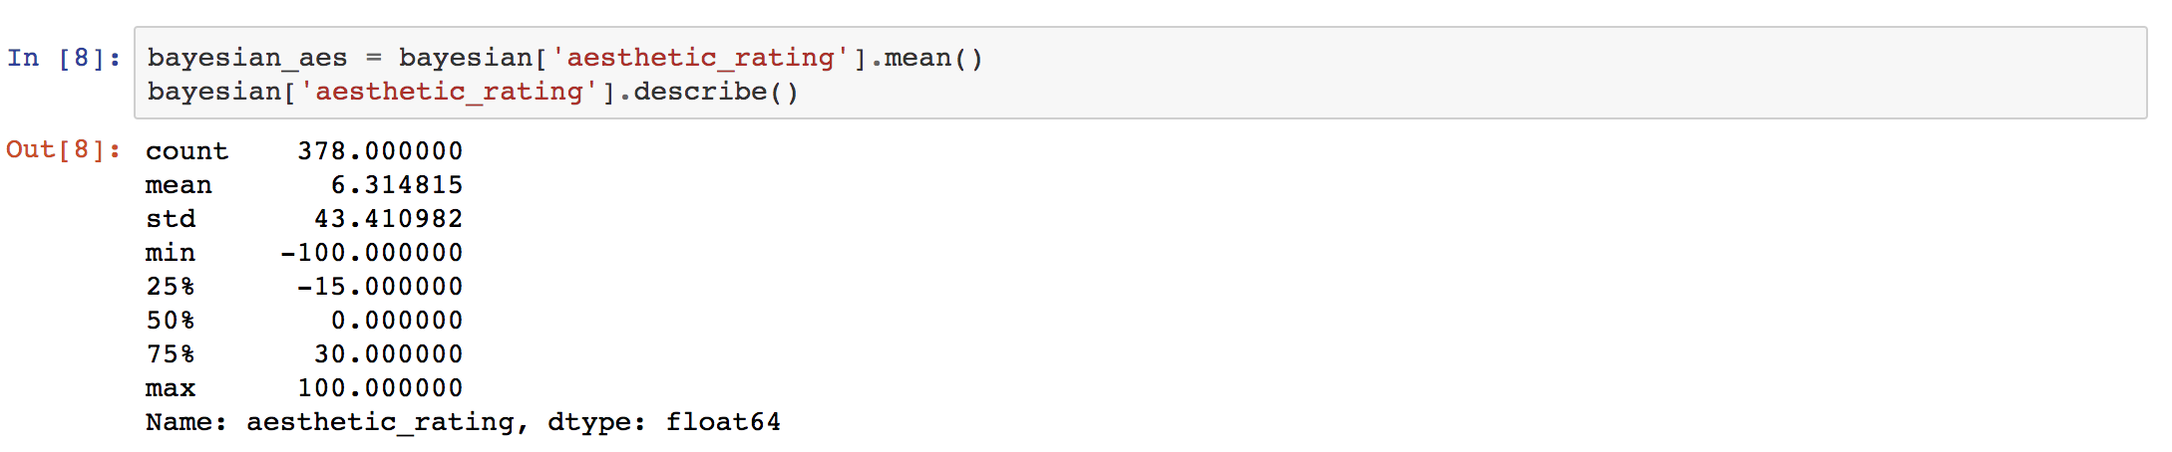
DATA ANALYSIS & VISUALIZATION
1. Accuracy & Aesthetics by Model Type
Notes:
I also used the .mean() method to get the average aesthetic rating for each model.

Slide 19
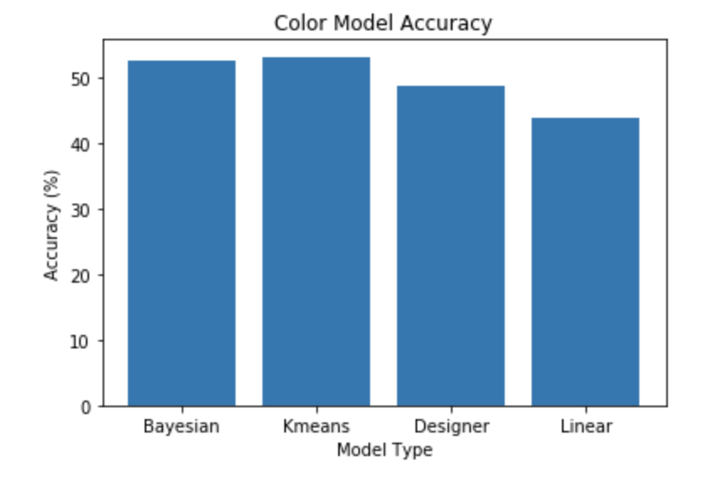
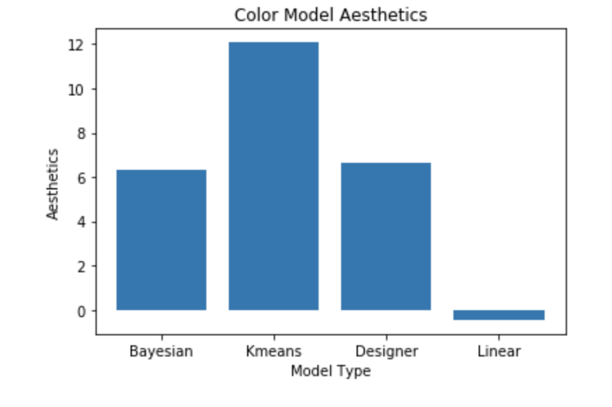
DATA ANALYSIS & VISUALIZATION
1. Accuracy & Aesthetics by Model Type
52.64%, 53.17%, 48.68%, 43.92%
6.31, 12.07, 6.61, -0.45
Notes:
And here are the visualizations for my results: we can see here that color ramps generated by our K means and Bayesian models outperformed the designer and linear models in accurate numerical mapping, and K means method even outperformed designer ramps in aesthetic rating, meanwhile the Bayesian method was considered far more pleasant looking than the linear approach, which was honestly a really exciting result.

Slide 20
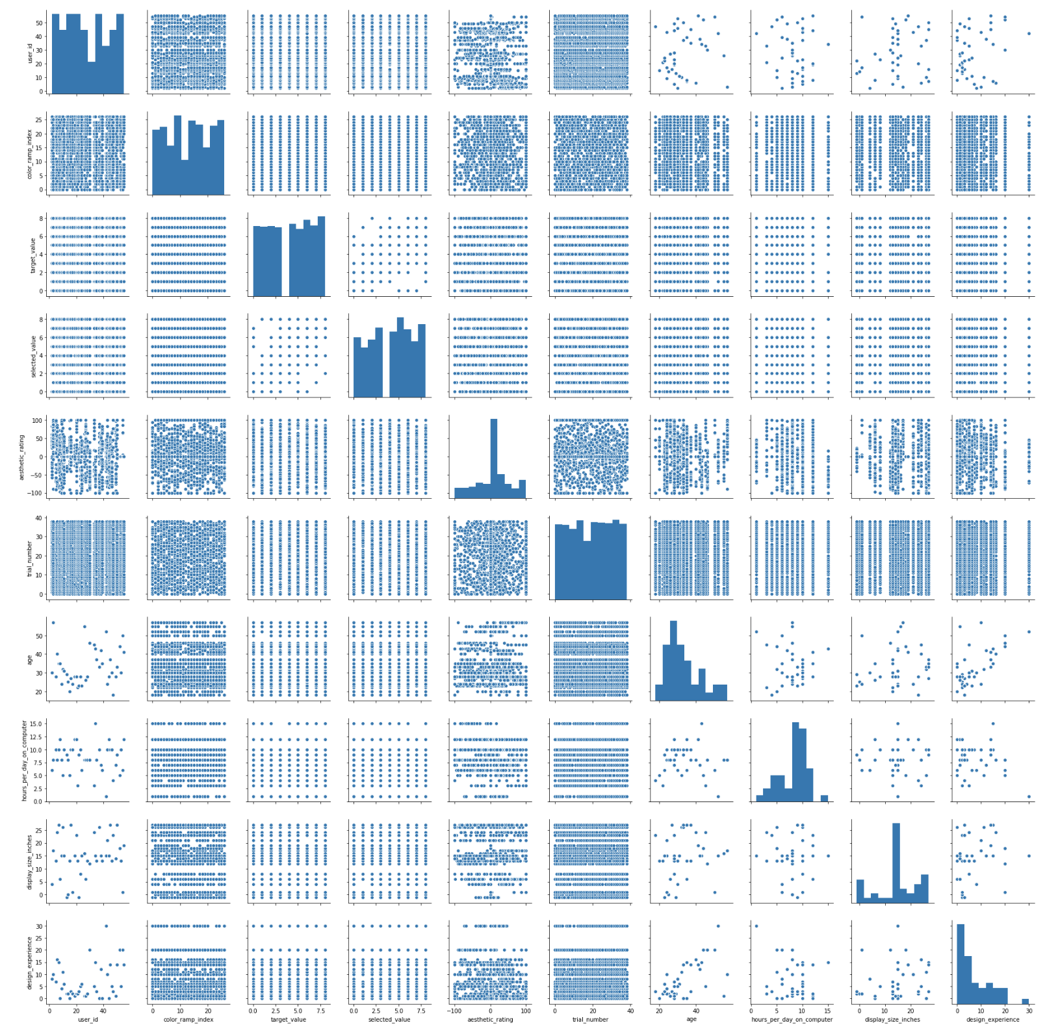
DATA ANALYSIS & VISUALIZATION
2. Aesthetics
Notes:
And then I was also interested in knowing more about what was the most important factor in influencing the aesthetic judgement. So I first did a pair plot to explore the data, which, however, didn’t seem to give me too much information.

Slide 21
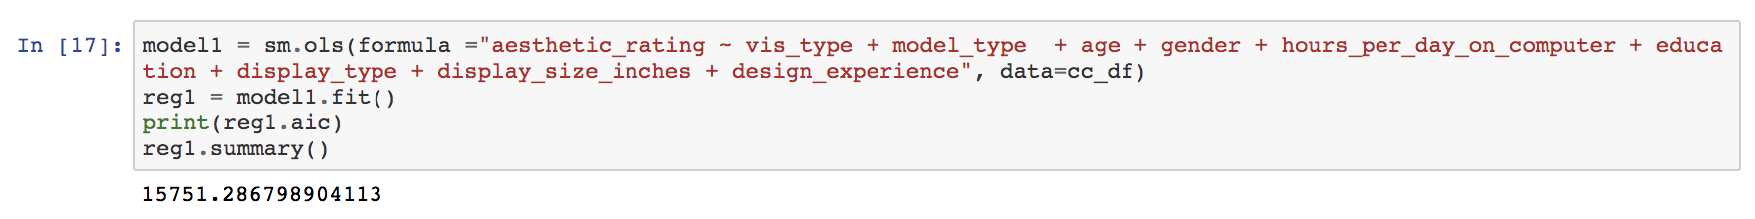
DATA ANALYSIS & VISUALIZATION
2. Aesthetics
Notes:
Then I did a multiple regression on the data with aesthetic rating as the dependent variable and vis_type, model_type, age, gender, hours_per_day_on comuter etc as independent variables.

Slide 22
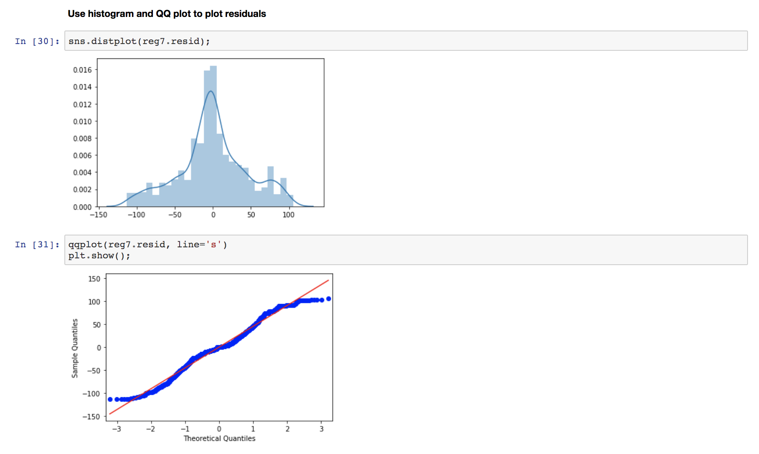
DATA ANALYSIS & VISUALIZATION
2. Aesthetics
display_size
model_type
vis_type
Notes:
I used the backward p-value selection approach, and after several steps and condition check, I found that the top factors to influence the aesthetic rating in this study were
display_size, model_type and vis_type. I was kind of surprised that display size was so important in aesthetic judgement, but my guess was some participants finished this study on their phone, some on their laptop, and since our experiment was deployed a web-server, there might've been some responsive design issues around.

Slide 23
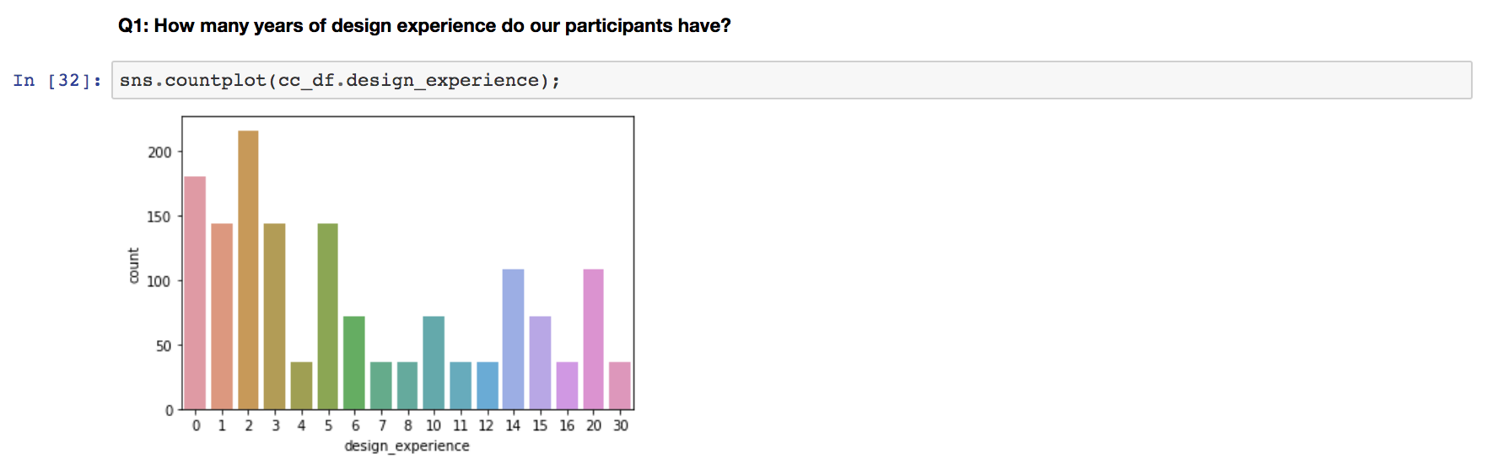
DATA ANALYSIS & VISUALIZATION
3. Designer Demographics (Univariate)
Notes:
Then I took a closer look at the designer demographics to see if there were any interesting patterns in the data. Here are the visualizations of my results:
From the univariate perspective, I found most participants in our study were junior designers who had fewer than 5 years design experience.

Slide 24
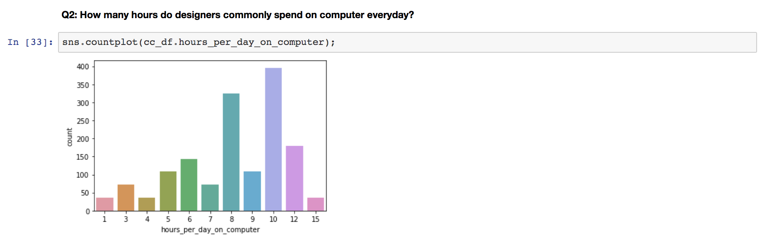
DATA ANALYSIS & VISUALIZATION
3. Designer Demographics (Univariate)
Notes:
Just like many of us, most designers spend more than 10 hours per day on their computers.

Slide 25
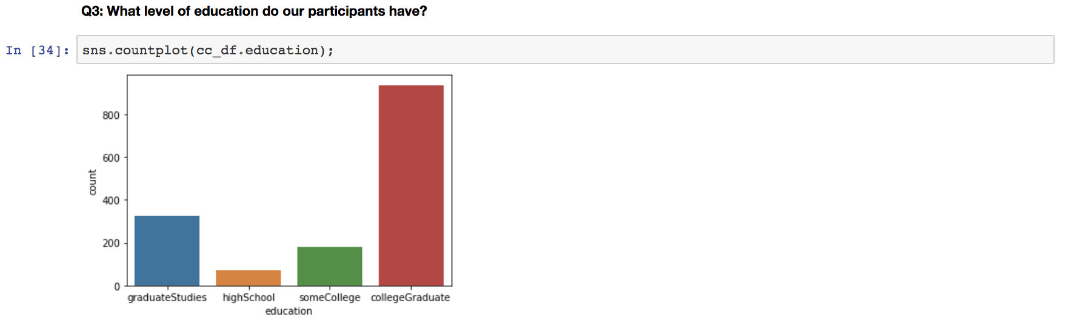
DATA ANALYSIS & VISUALIZATION
3. Designer Demographics (Univariate)
Notes:
Most of the participants were college graduates, only a few of them went to graduate school.

Slide 26
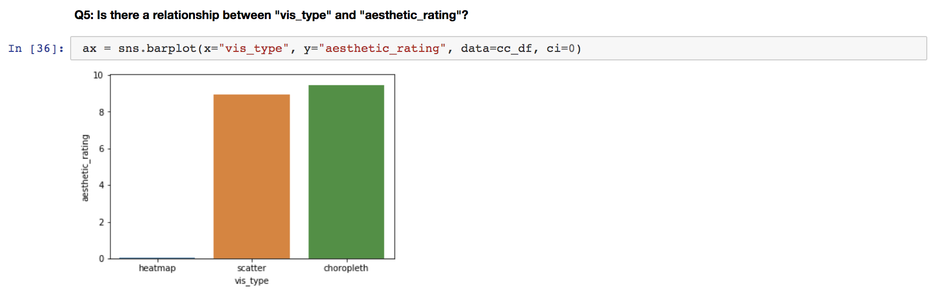
DATA ANALYSIS & VISUALIZATION
3. Designer Demographics (Bivariate)
Notes:
From the bivariate perspective, I looked at the relationship between vis type and aesthetic rating, interestingly, I found that heat map had significantly lower aesthetic rating compared to the scatter plot and choropleth map, however, it is unclear whether there is a correlation between these two variables, and I haven't seen any evidence in our field to investigate this thing so this might be an interesting topic for future work.

Slide 27
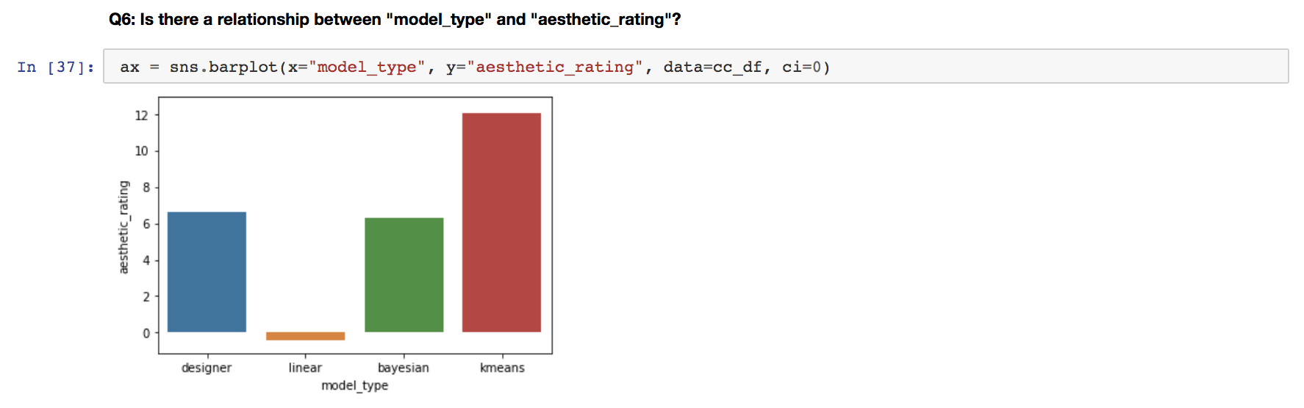
DATA ANALYSIS & VISUALIZATION
3. Designer Demographics (Bivariate)
Notes:
And i looked at the relationship between model_type and aesthetic_rating, which seemed to align with my prior calculation, where color ramps generated by our kmeans model outperformed the others, followed by designer ramps, Bayesian models and linear.

Slide 28
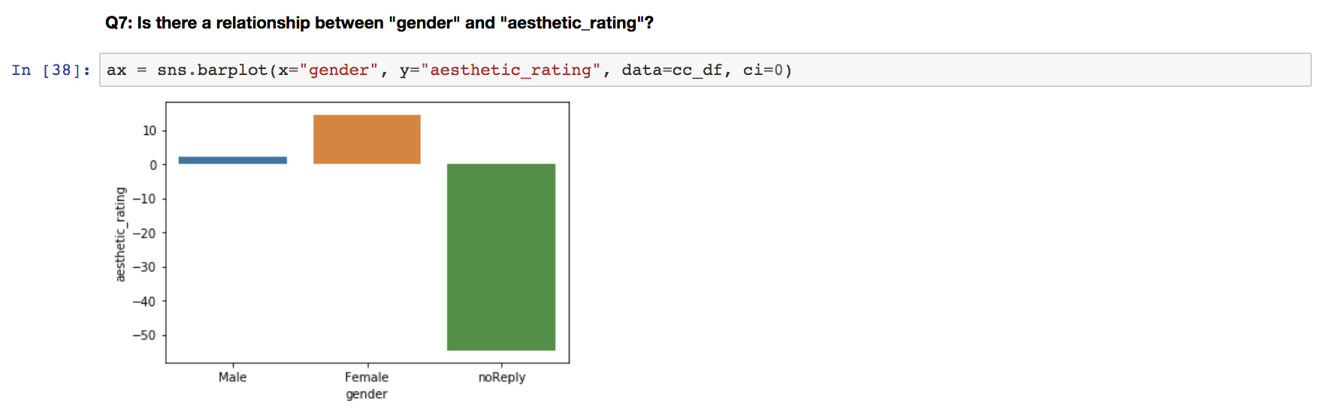
DATA ANALYSIS & VISUALIZATION
3. Designer Demographics (Bivariate)
Notes:
Finally, I looked at gender and aesthetic rating, and found that female designers seemed to give overall higher ratings than male designers. This made me think, maybe another interesting direction for this project moving forward could be investigating the gender differences in aesthetic preferences.

Slide 29
CONCLUSION & FUTURE WORK
Quantitative Findings:
Accuracy: K means > Bayesian > Designer > Linear
Aesthetics: K means > Designer > Bayesian > Linear
Qualitative Takeaways:
Female designers seemed to be more tolerant in terms of aesthetic rating
Visualization type might influence aesthetic rating
Notes:
So as a little summary of my findings over this analysis, I found our models did a good job in supporting both the accuracy and aesthetic tasks, and thus would be a promising project to keep working on,
Our next step in the near future is to. incorporate our models into a color picker tool to help designers of different levels to choose good color ramps for visualization design.
Meanwhile, interesting qualitative tings that are worth further investigation are the sex differences in aesthetic rating, and vis type differences in aesthetic rating.

Slide 30
THANKS!
Notes:
That is pretty much of it, thanks for your attention.

